Slide 1
Project Housing: Sales Price Prediction
Presented By: Rohan V Borade

Slide 2
TOPICS:
Overview.
Problem Statement.
Problem Understanding.
Exploratory data analysis.
Visualizations.
Analysis.
Data cleaning steps.
Model Building.
Hyper Parameter Tunning.
Saving the model and predictions from saved best model.
Conclusion.

Slide 3
Overview:
In this particular presentation we will be looking on:
What are the EDA steps in cleaning the dataset.
Overall analysis on the problem.
Model building from train dataset.
Predicting Housing Price for test dataset.

Slide 4
Problem Statement:
A US-based housing company named Surprise Housing has decided to enter the Australian market. The company uses data analytics to purchase houses at a price below their actual values and flip them at a higher price. For the same purpose, the company has collected a data set from the sale of houses in Australia. The data is provided in the CSV file below.
The company is looking at prospective properties to buy houses to enter the market. You are required to build a model using Machine Learning in order to predict the actual value of the prospective properties and decide whether to invest in them or not. For this company wants to know:
• Which variables are important to predict the price of variable?
• How do these variables describe the price of the house?

Slide 5
Problem Understanding:
House price prediction can help the developer determine the selling price of a house and can help the customer to arrange the right time to purchase a house. House Price prediction, is important to drive Real Estate efficiency. As earlier, House prices were determined by calculating the acquiring and selling price in a locality. Therefore, the House Price prediction model is very essential in filling the information gap and improve Real Estate efficiency. The aim is to predict the efficient house pricing for real estate customers with respect to their budgets and priorities. By analysing previous market trends and price ranges, and also upcoming developments future prices will be predicted. ... cost of property depending on number of attributes considered. Now as a data scientist our work is to analyse the dataset and apply our skills towards predicting house price.

Slide 6
What is Housing Price Prediction?
Prediction house prices are expected to help people who plan to buy a house so they can know the price range in the future, then they can plan their finance well. In addition, house price predictions are also beneficial for property investors to know the trend of housing prices in a certain location.

Slide 7
Exploratory Data Analysis (E.D.A):
While checking for null values in data set I found null values in most of the columns and I have used imputation method to replace those null values (mode for categorical column and mean for numerical columns).
In Id and Utilities column the unique counts were 1168 and 1 respectively, which means all the entries in Id column are unique and ID is the identity number given for particular asset and all the entries in Utilities column were same so these two column will not help us in model building. So I decided to drop those columns.
And all these steps were performed to both train and test datasets separately.

Slide 8
Analysis:
I have used box plot for each pair of categorical features that shows the relation with the median sale price for all the sub categories in each categorical feature.
let's make a variable that indicates 1 if the observation was missing or zero otherwise
let's calculate the mean SalePrice where the information is missing or present
Using group by feature and SalePrice median and also plot the bar plot to get insigths of dataframe.
Explore the years unique features using Yrsold and SalePrice we have glance of relationship between using group by median plot we can see that price of the house is decreasing as yearsold is passing.
And also for continuous numerical variables I have used to show the relationship between continuous numerical variable and target variable.
By using scatter plot we will capture difference between year variable and year the house was sold for.
My analysis is that except SalePrice no other features as normal distribution are having some skewness.
To analyse the continuous values by creating histogram understand the distribution
I found that there is a linear relationship between continuous numerical variable and SalePrice.

Slide 9
Data Cleaning Steps:
In my datasets I found null values, outliers and also skewness.
I have used replaced the missing value with new label . There are outliers in the numerical feature so we will to median to replace nan value.
To remove skewness we have used log transformation on numerical features of dataset which had skewness convert it in log normal distribution.
To get percentage of categorial feature we will group by the feature present in feature column with respect to saleprice count and divided by whole length of the dataset.
To encode the categorical columns I have use Ordinal Encoding.
Also I have used standardization. Then followed by model building with all regression algorithms.

Slide 10
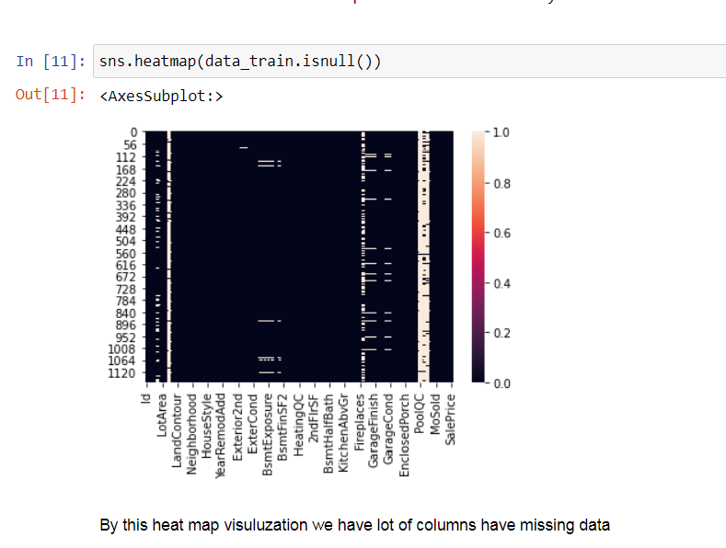
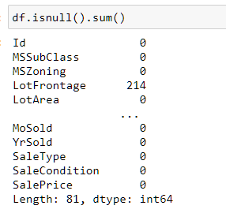
VISUALIZATION (CHECKING NULL VALUES)
First checking the Null values for the data. After that removing the Null/missing data

Slide 11
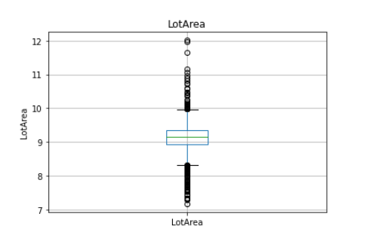
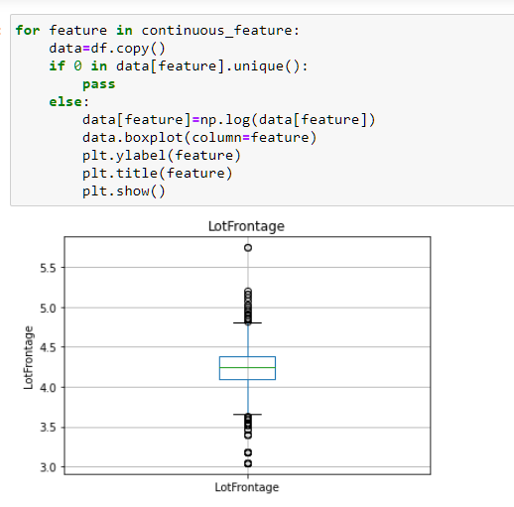
VISULIZATION (BOX PLOT)
BOX PLOT USED FOR CHECKING OULIERS.

Slide 12
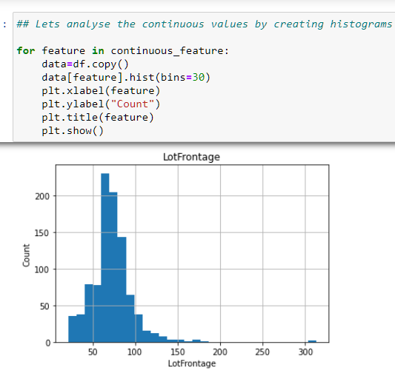
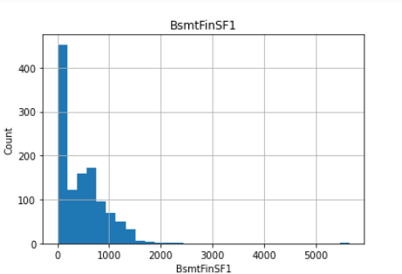
VISULIZATION (CHECKING SKEWENESS)
I will check how much skewness data contains.
Visualize through Histogram plot.

Slide 13
Model Building:
Since SalePrice was my target and it was a continuous column so this particular problem was Regression problem. And I have used all regression algorithms to build my model. By looking into the difference of r2 score and cross validation score I found GradientBoostingRegressor as a best model with least difference. Also to get the best model we have to run through multiple models and to avoid the confusion of overfitting we have go through cross validation. Below are the list of regression algorithms I have used in my project.
KNeighborsRegressor
AdaBoostingRegressor
GradientBoostingRegressor
DecisionTreeRegressor

Slide 14
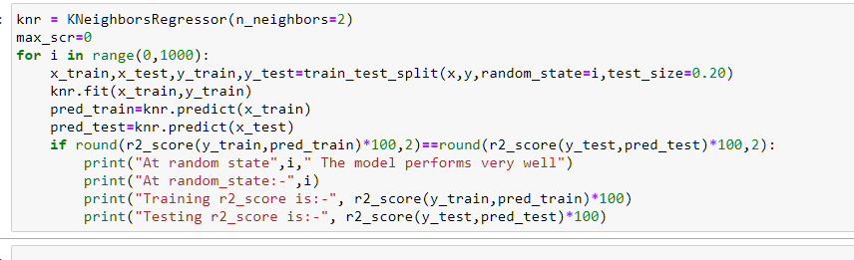
KNeighborsRegressor
KNeighborsRegressor is giving me of 87.19% accuracy.

Slide 15
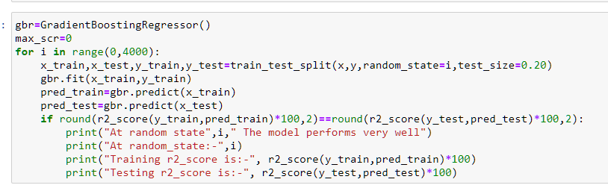
GradientBoostingRegressor:
GradientBoostingRegressor is giving me 91.04% accuracy.

Slide 16
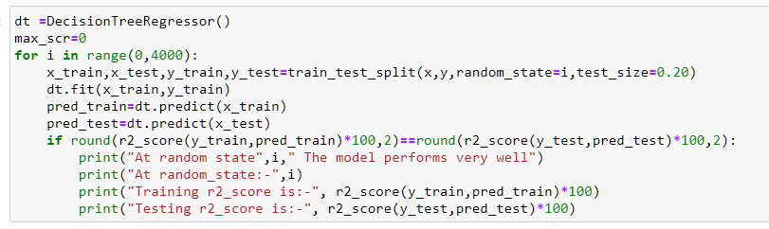
DecisionTreeRegressor:
DecisionTreeRegressor is giving me 73.91% accuracy.

Slide 17
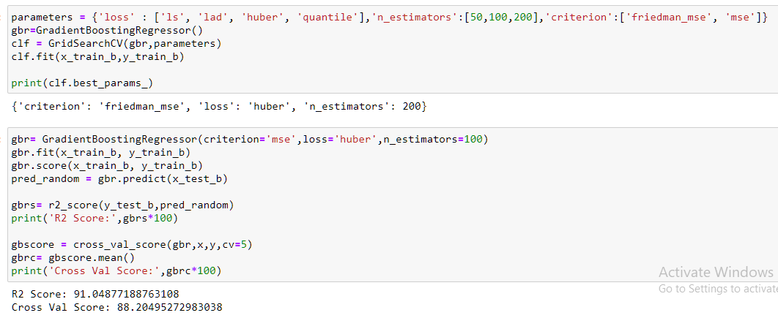
Hyper Parameter Tunning:
I have choosed all parameters of GradientBoostingRegressor, after tunning the model with best parameters I have increased my model accuracy from 90.21% to 91.04%.

Slide 18
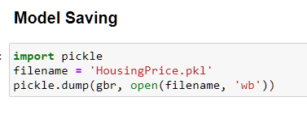
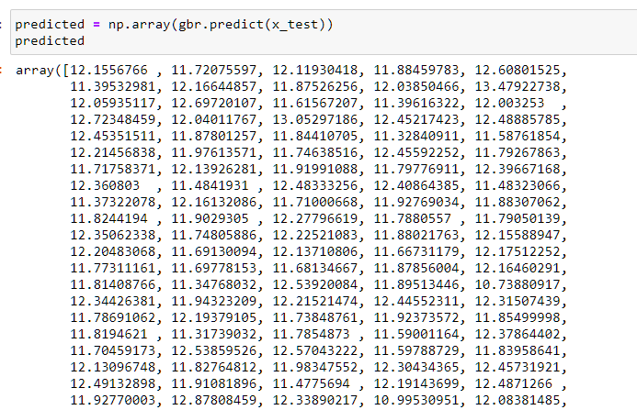
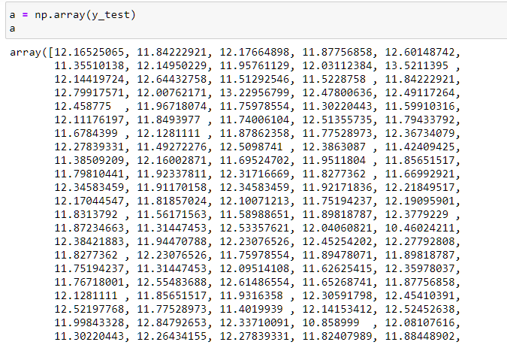
Saving the model and predictions using saved model:
I have saved my best model using .pkl as follows.
Now after saving the best model, loading my saved model and predicting the test values.
I have predicted the SalePrice for test dataset using saved model of train dataset, and the predictions look good. I have also saved my predictions for further analysis.

Slide 19
Conclusion:
In this project report, we have used machine learning algorithms to predict the house prices.
We have mentioned the step by step procedure to analyze the dataset and finding the correlation between the features. Thus we can select the features which are not correlated to each other and are independent in nature.
Those feature sets were then given as an input to four algorithms and a csv file was generated consisting of predicted house prices.
Hence we calculated the performance of each model using different performance metrics and compared them based on these metrics. Then we have also saved the dataframe of predicted prices of test dataset.
To conclude, the application of machine learning in property research is still at an early stage. We hope this study has moved a small step ahead in providing some methodological and empirical contributions to property appraisal, and presenting an alternative approach to the valuation of housing prices.

Slide 20
THANK YOU

